Slide 1
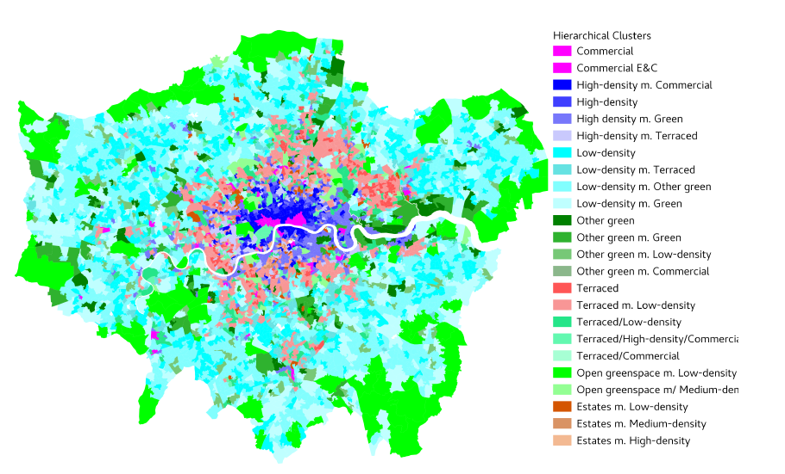
Unsupervised Clustering Results

Slide 2
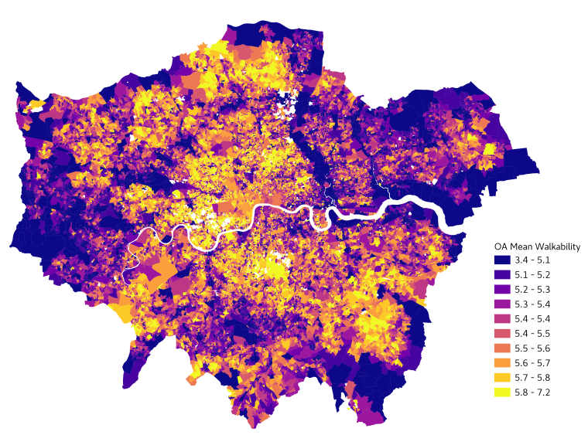
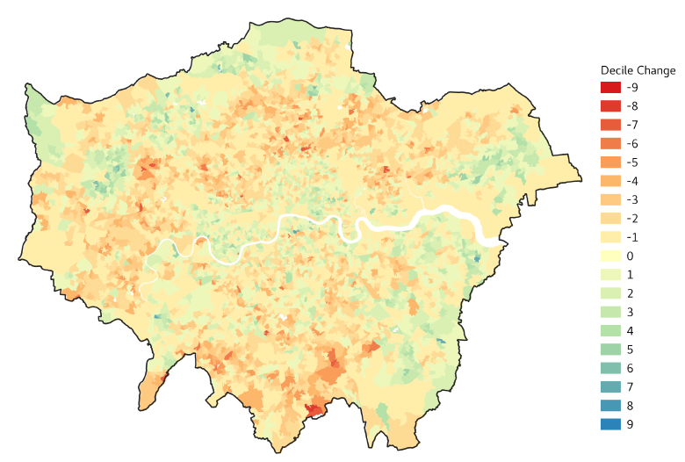
Perception Results
OA perceptions
LSOA Δ(2021-2011)perceptions
Notes:
Changes in perceived walkability
1

Slide 3
Questions
What is the distribution of the following variables across urban typologies (i-LOAC)?
London Atmospheric Emissions Inventory (LAEI)
Wealth
Deprivation
To what extent are perception-based measures correlated with objective measures:
Deprivation Indices
How are neighbourhood perceptions distributed across the population (WHO)?
Population age groups, ethnicity, LOAC, CRDC.
Are changes in perceptions associated with changes in residential population?
Census, Residential Moves - (CRDC) [House Price paper].
Are changes in perceptions associated to changes in life expectancy?
Life expectancy estimates

Slide 4
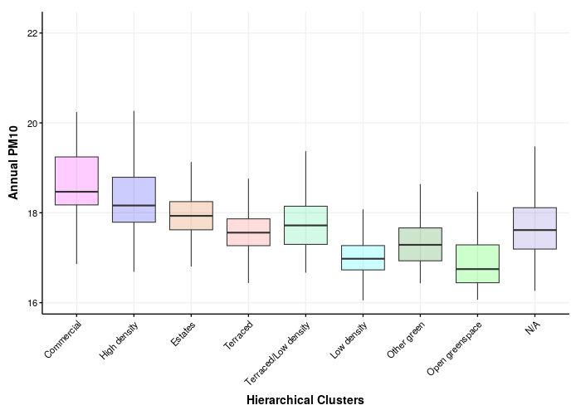
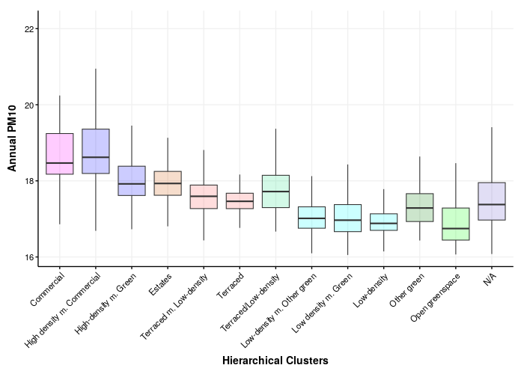
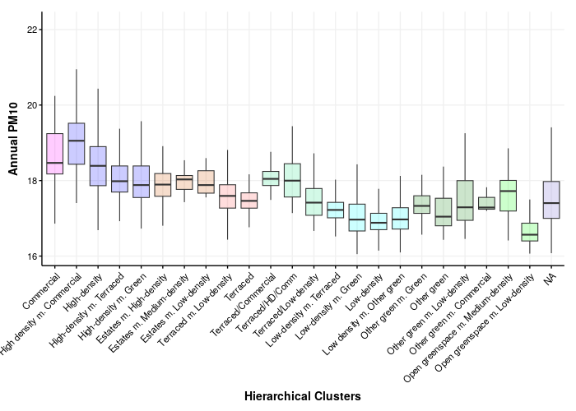
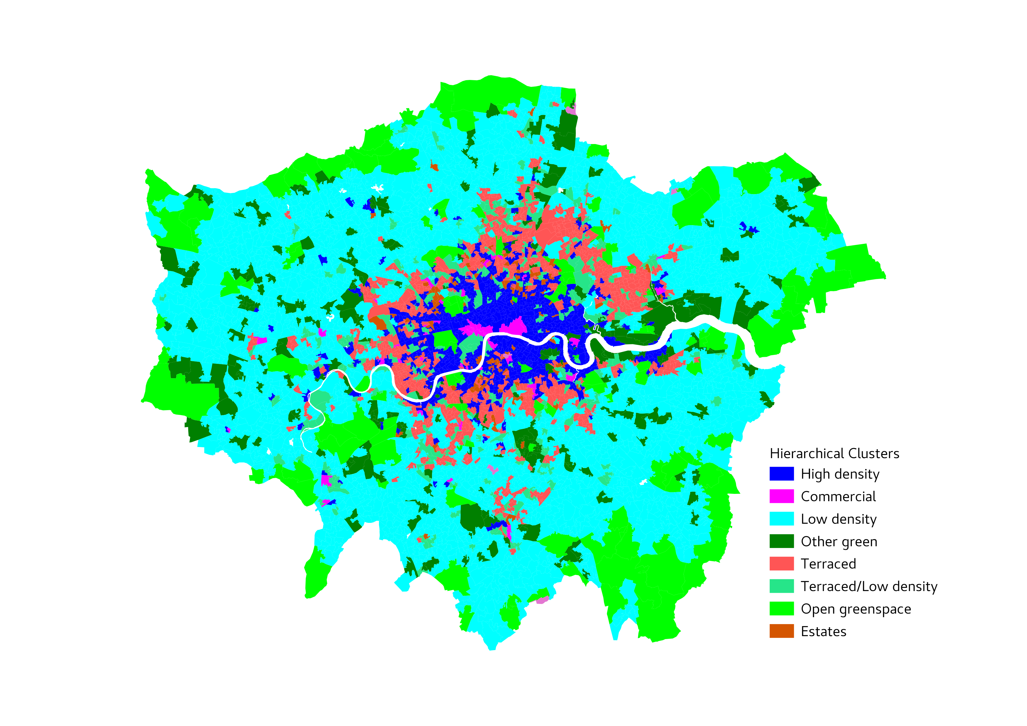
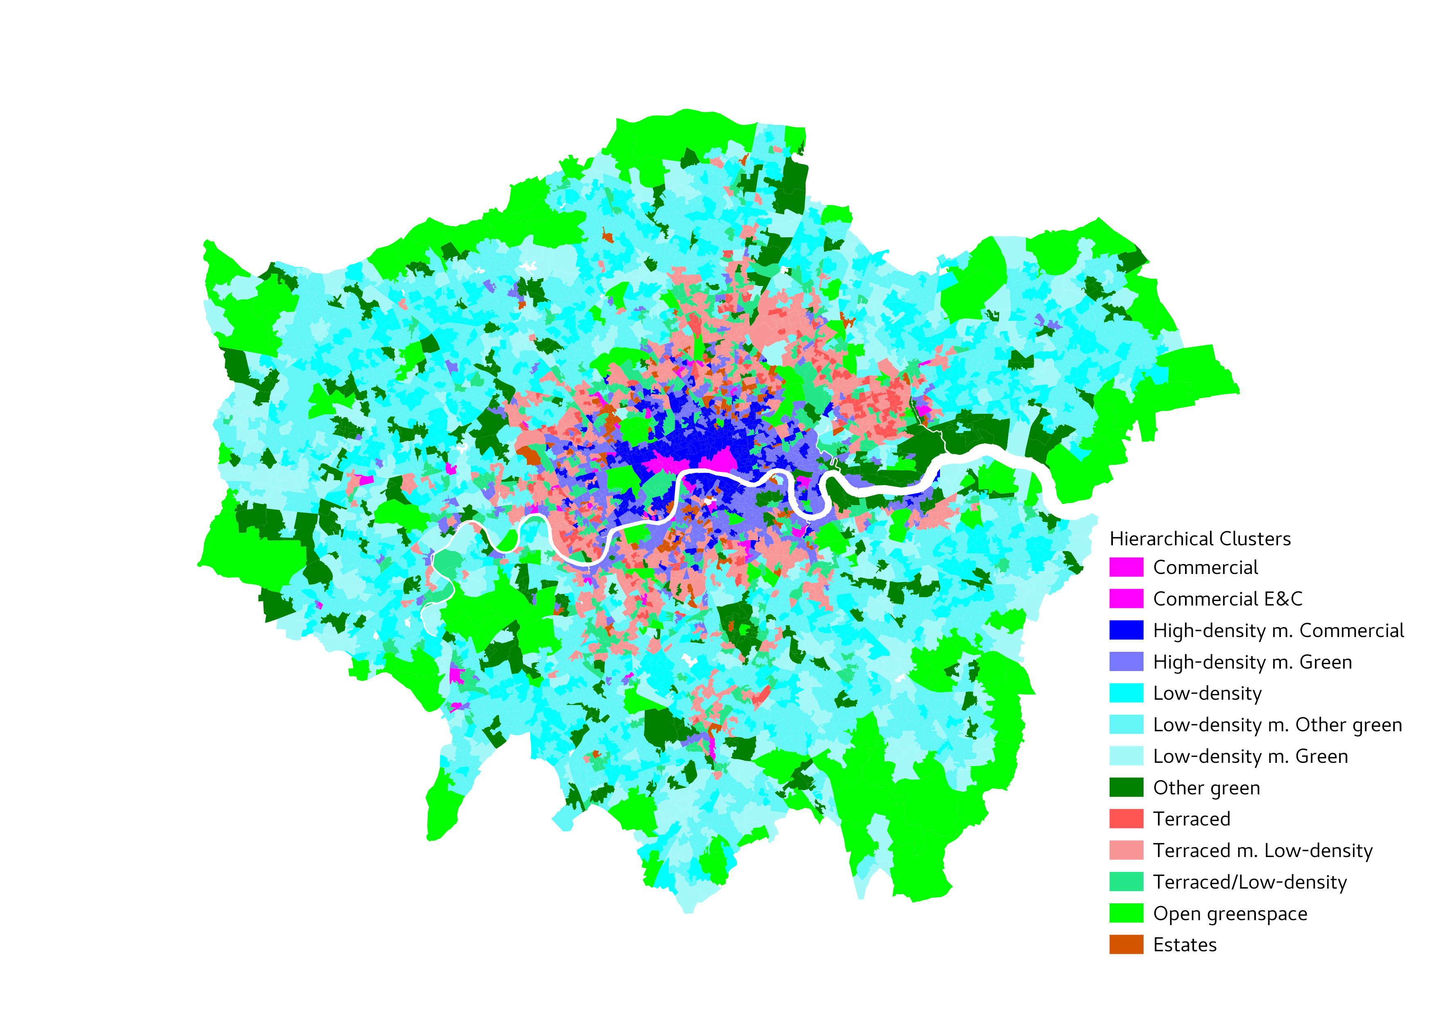
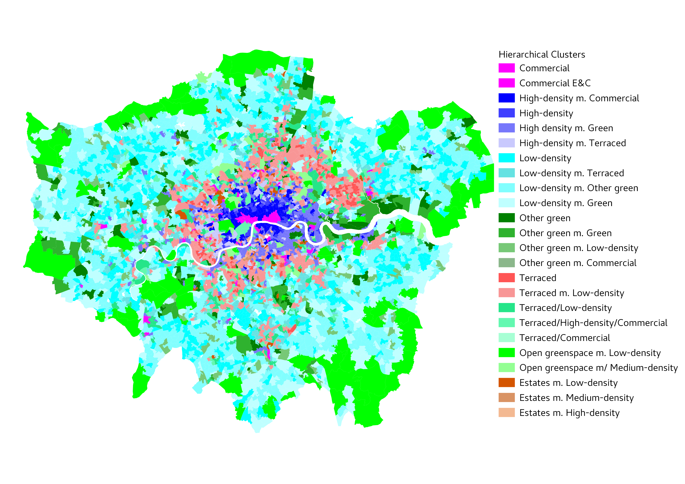
PM10 Annual

Slide 5
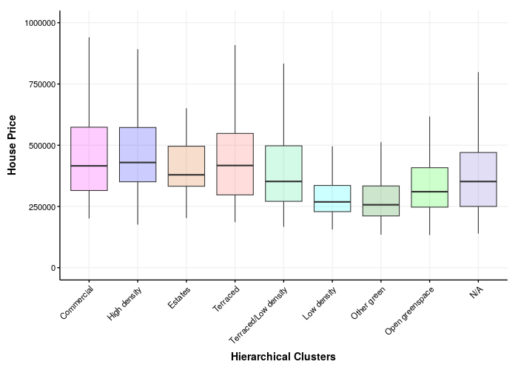
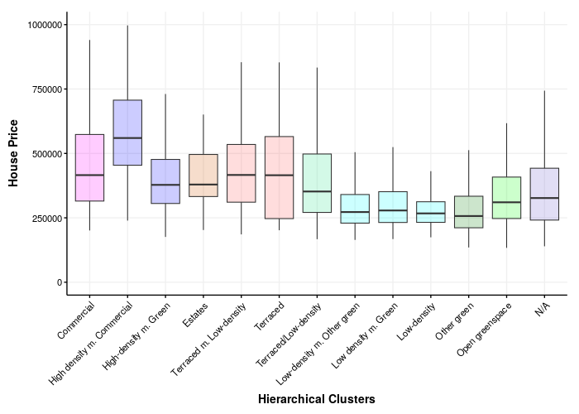
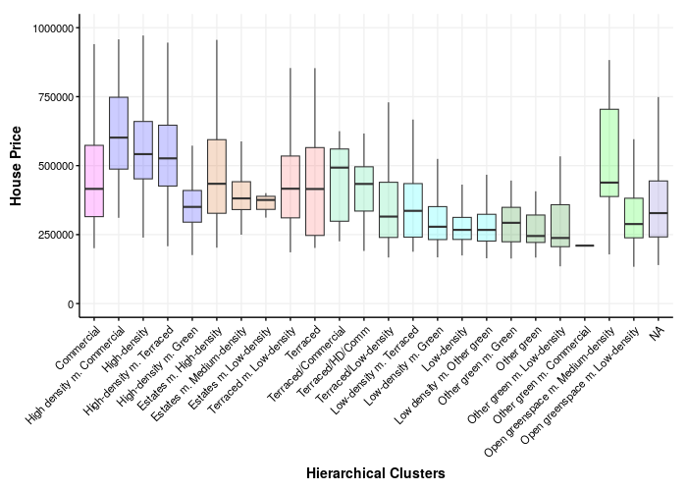
House Prices in London

Slide 6
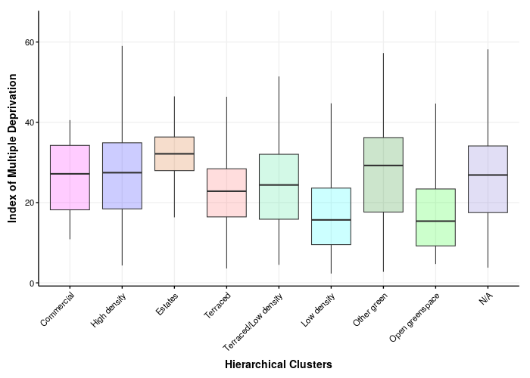
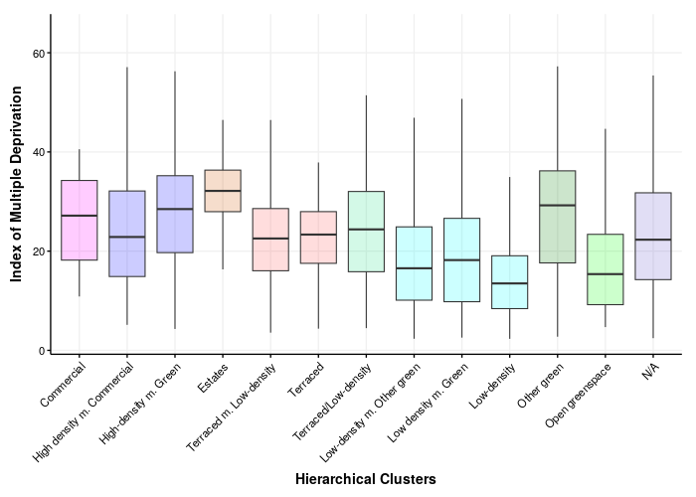
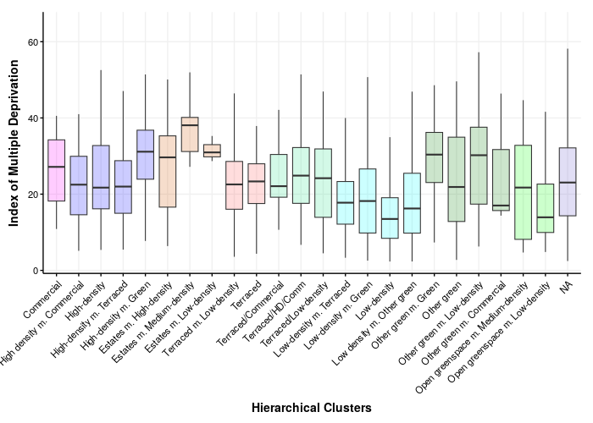
IMD Score in London

Slide 7
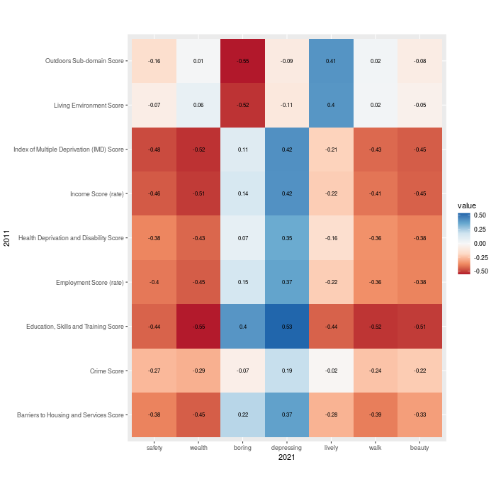
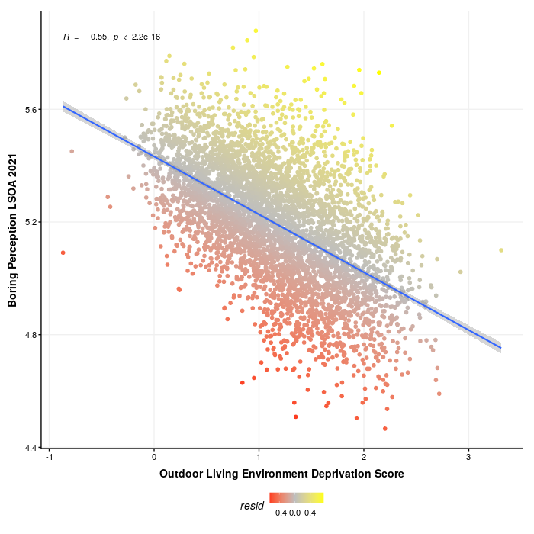

Slide 8
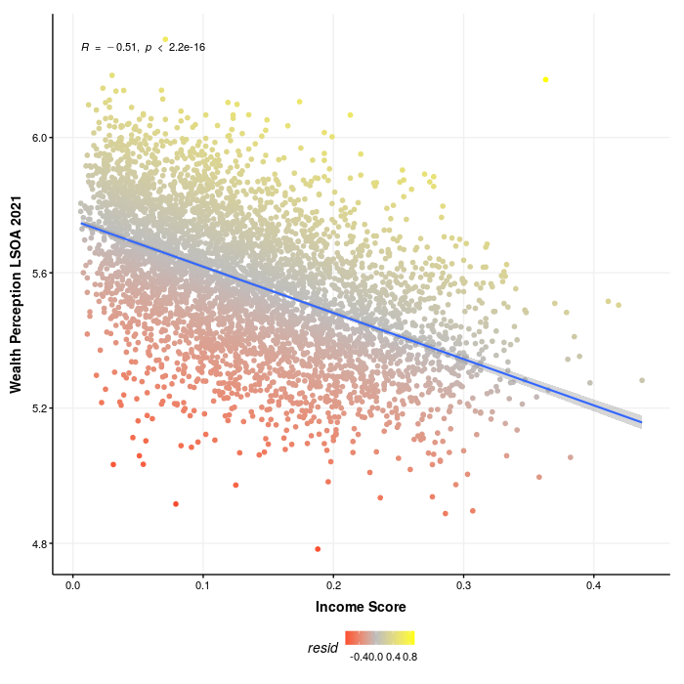
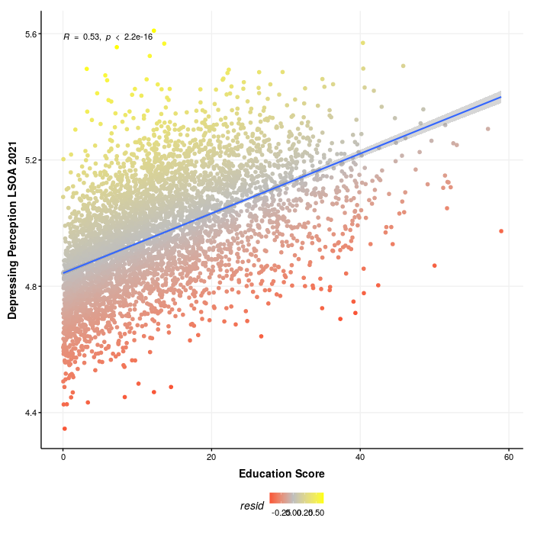
Perceived more boring than outdoor deprivation score prediction.
Perceived less wealthy than income deprivation score
Perceived more depressing than education score

Slide 9
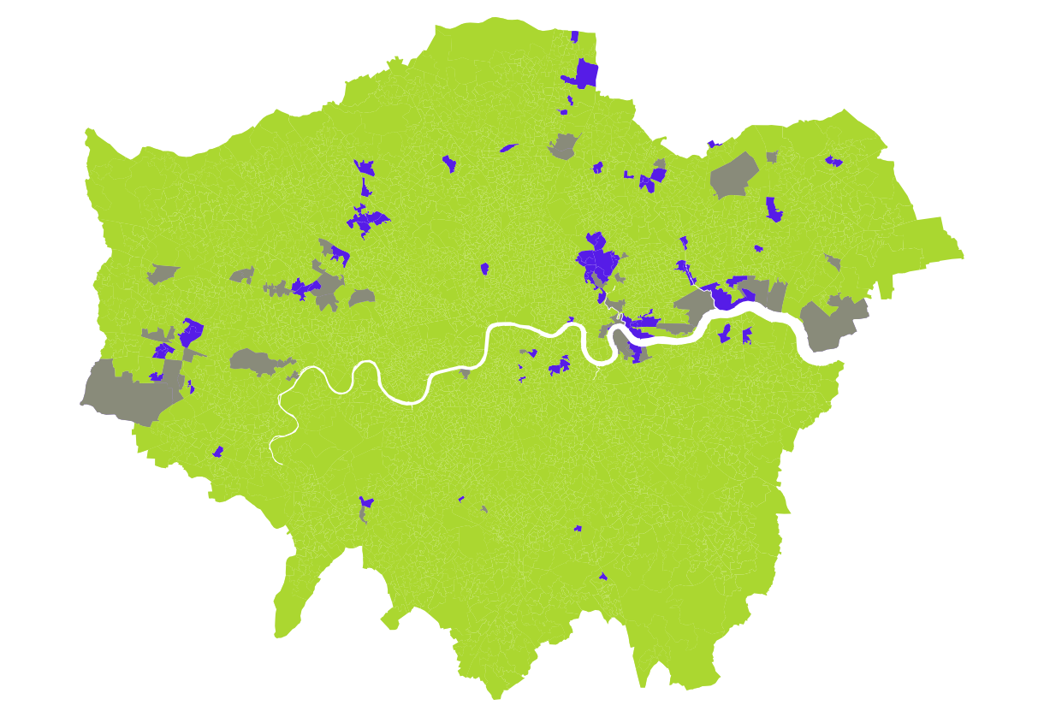
Bottom Decile of Residuals
These 77 LSOAs are:
Perceived to be less wealthy than expected based on income deprivation score.
Perceived to be more boring than expected based on living environment deprivation score. (More boring = less deprived quality of environment).
Perceived to be more depressing than expected based on education deprivation score.

Slide 10
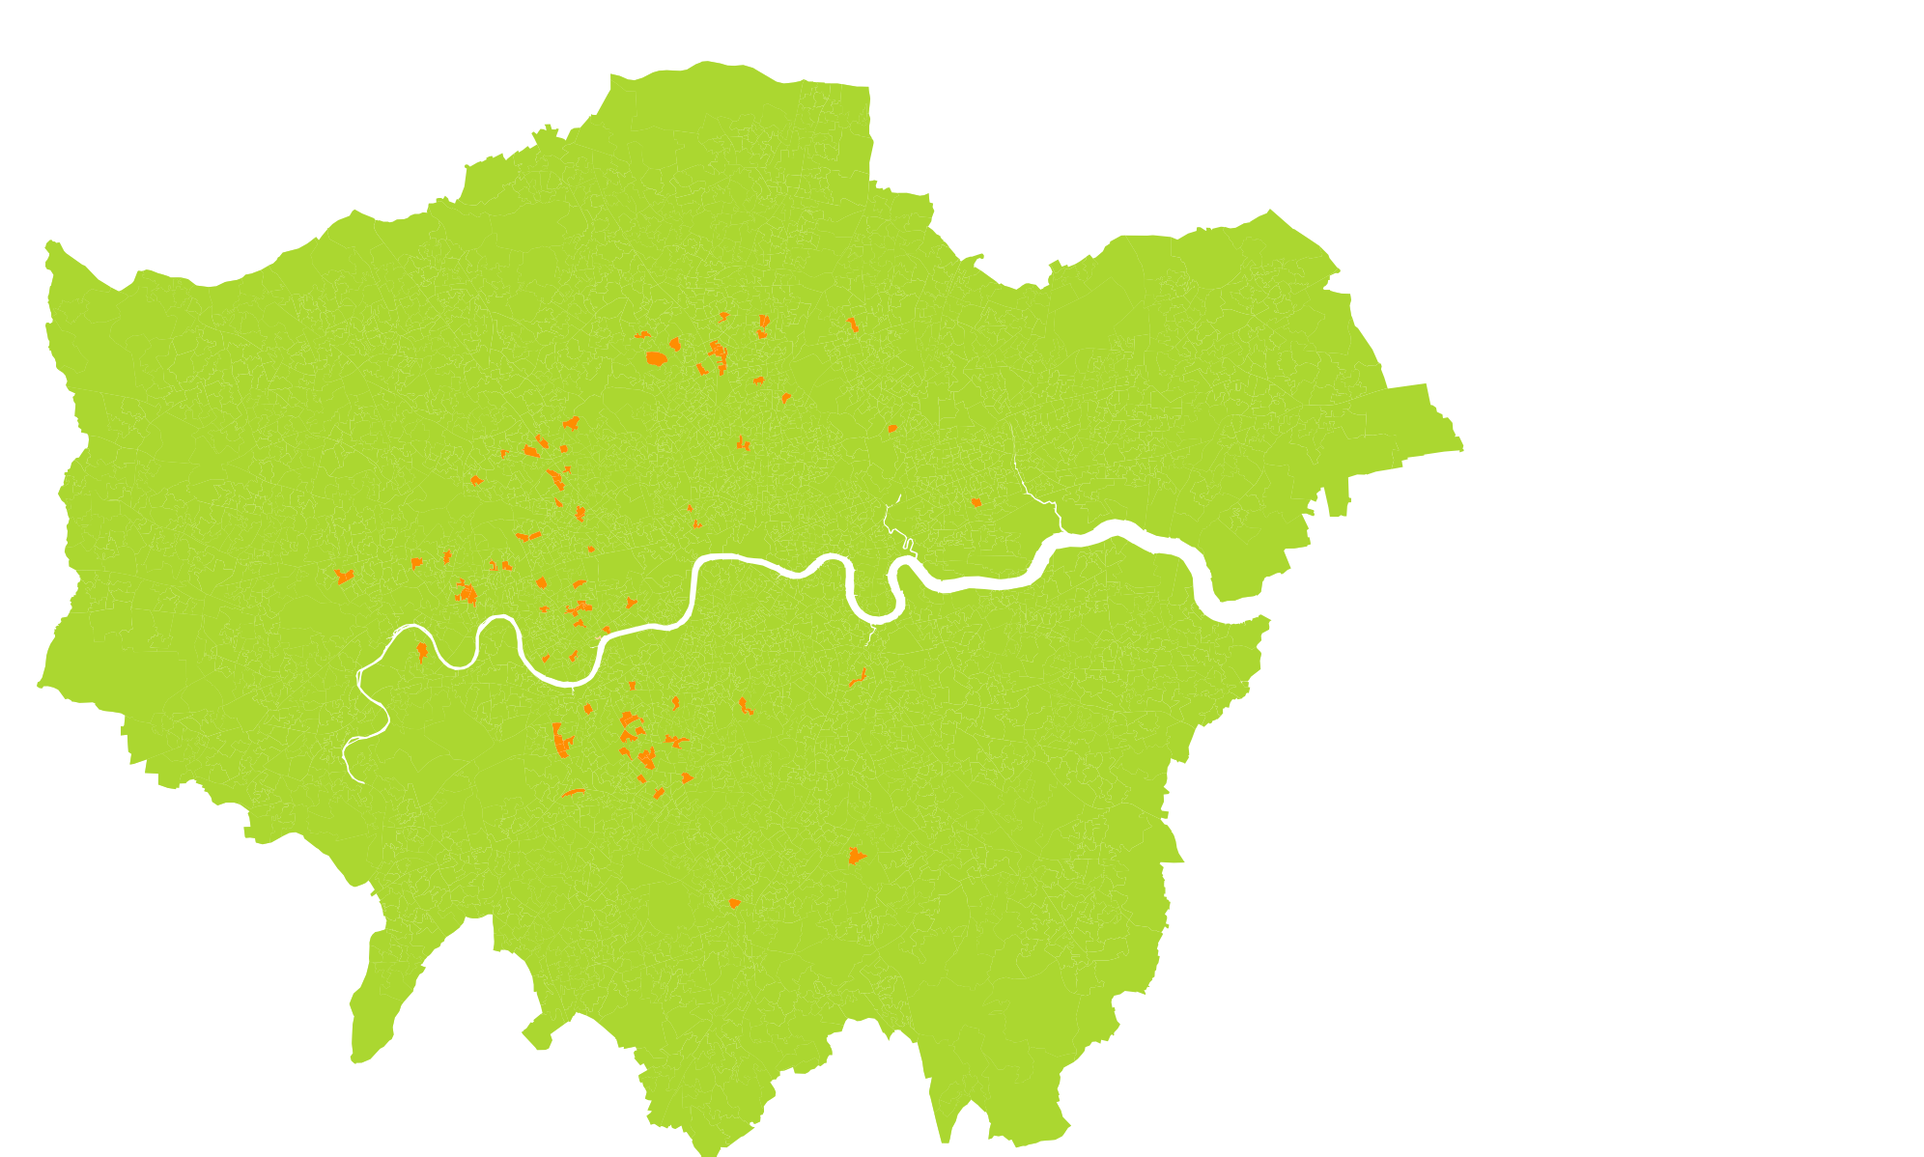

Slide 11
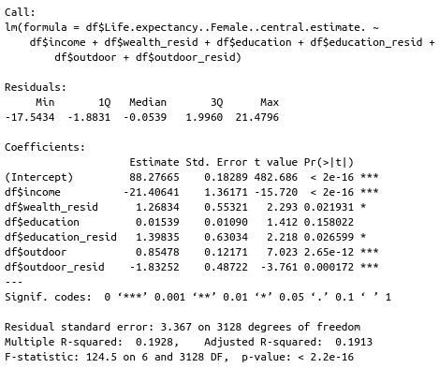
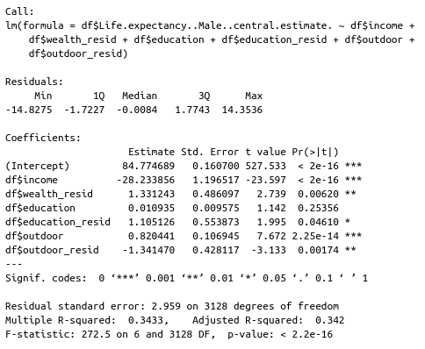
Lower wealth perception =
More deprived income
Lower boring perception =
More deprived outdoors
Higher depressing perception =
More deprived education

Slide 12
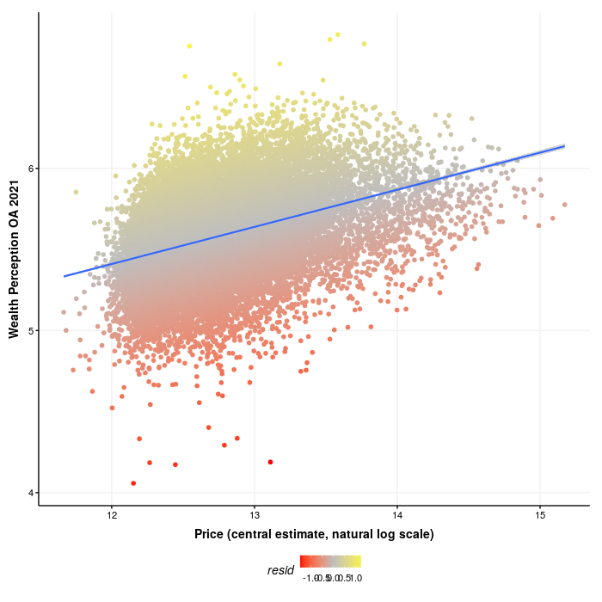
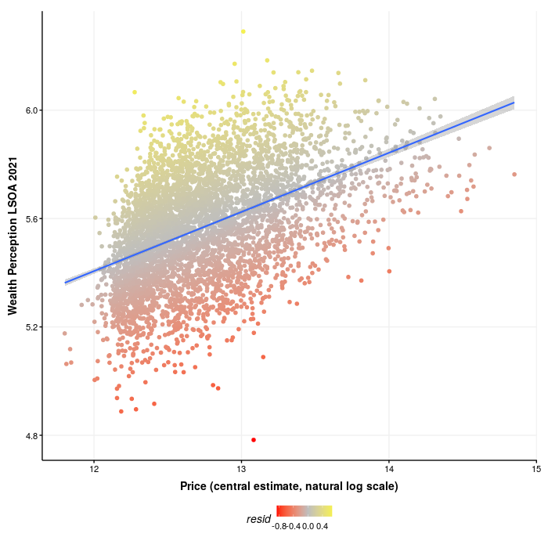
Perceptions of Wealth and House Prices – OA (left) and LSOA (right).
Notes:
1

